Slide 1

Be Different
1 Corinthians
Dr. Rick Griffith • Crossroads International Church Singapore
BibleStudyDownloads.org

Slide 2
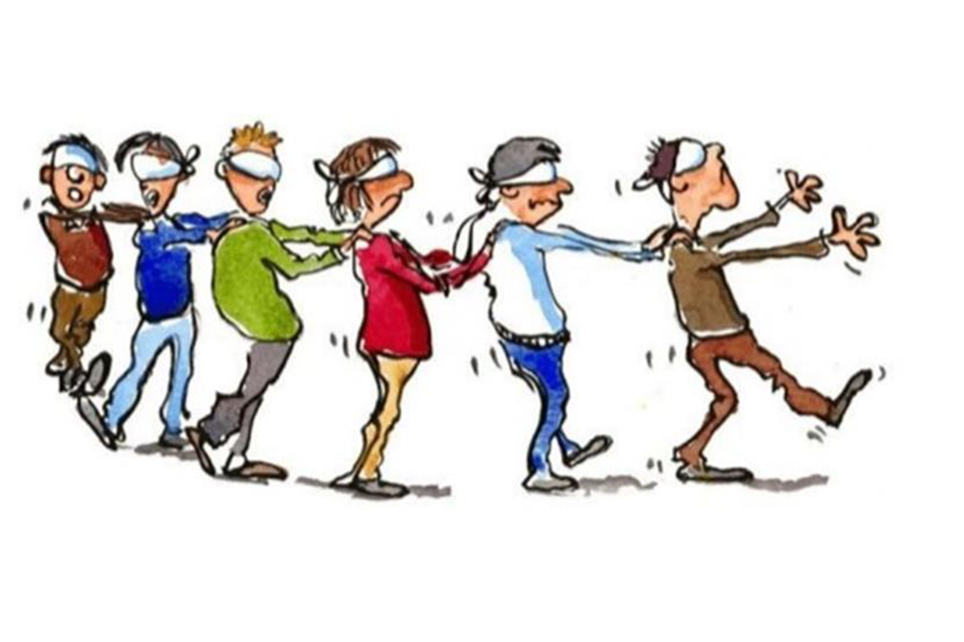
Herd Mentality
Notes:
We all are too keenly aware that there is a herd mentality in our world. It seems that the blind keeps leading the blind—insisting that we slavishly follow.
This week the governor of Virginia publicly argued for infanticide—and millions supported him!
Then pictures arouse of his racism while in medical school—so now politicians of his own party are calling for his resignation!
Since when is prejudice worse than killing babies right after birth?

Slide 3
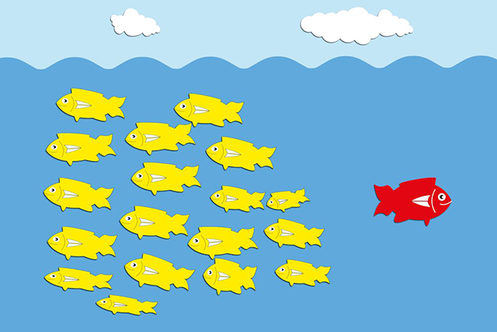
Be Different
Notes:
In a world where right is considered wrong and wrong is deemed right, God has called believers to be different.

Slide 4

Be different.
Notes:
We aren’t called to be upside down.

Slide 5
Be Different
Notes:
The reality is that God has called us to upright living in an upside down world.

Slide 6
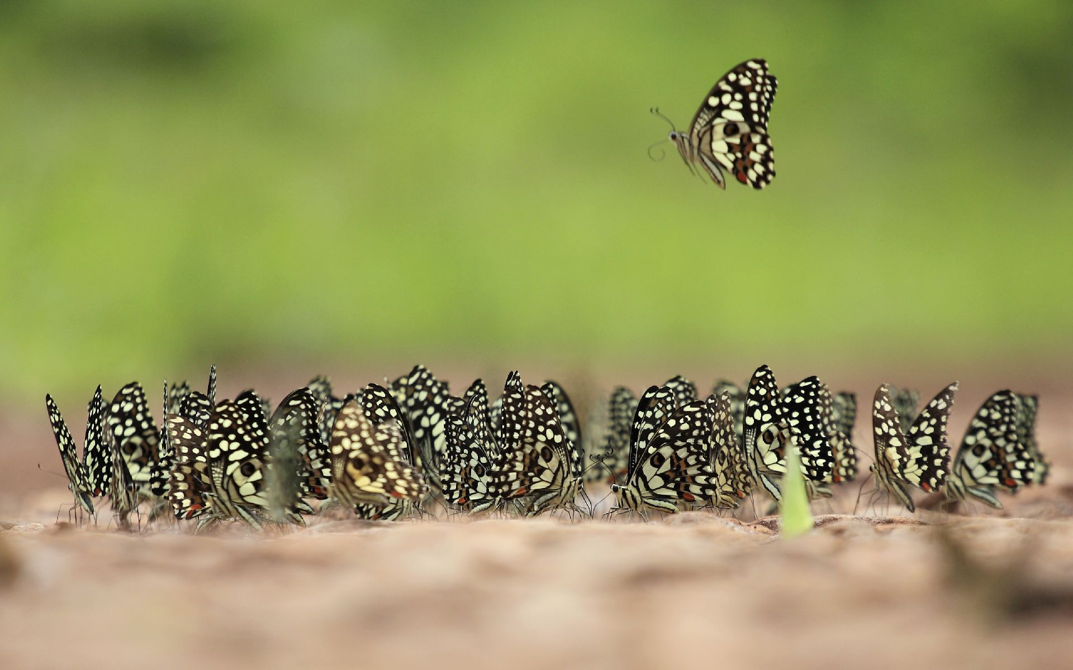
“Different” in this book means better.
Notes:
So today as I talk about being different, please see that I mean to rise above the fray to be different in the positive sense. The idea is not just to be weird to gain attention or “be yourself.” It is to act in a manner pleasing to the Lord—even if you have to do it alone.
For example:
Does your presence unify or divide others around you?
Are your personal ethical standards higher than those who do not claim Jesus?
Do you handle difficulties differently—in a way prioritizing other people over yourself?

Slide 7

How should we be different from unbelievers?
Notes:
How should we be different from unbelievers? I just told you three ways!
What are some of the ways that God wants your life to escape the herd mentality?
How does Jesus desire you to rise above the fray?

Slide 8

Background
Notes:
Today we will study a letter written to a group of believers who really struggled with getting out of the mentality of their fish bowl—but God wanted them to escape these values while still remaining in the bowl.

Slide 9

God put the Corinthian believers in their dark city to shine as his light.

Slide 10

Paul's 1st & 2nd Missionary Journeys
138-39
Notes:
Paul’s first journey from Antioch started churches in modern day Turkey.
Then his second trip expanded Christianity into Greece where he began the church at Corinth.

Slide 11
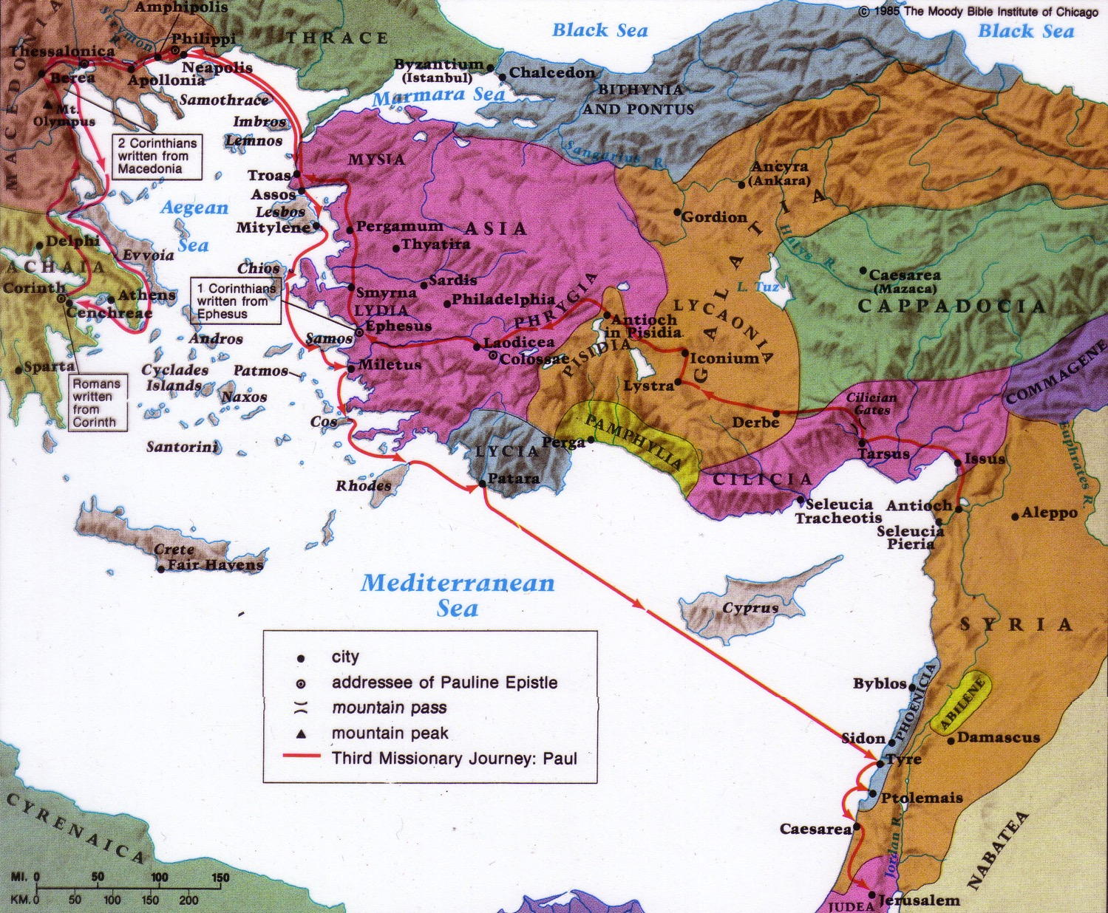
Origin & Destination
1 Corinthians on the Third Missionary Journey
157
Destination:
Corinth
Origin:
Ephesus
Notes:
On Paul’s third trip, he had a longer time in Ephesus where he heard about some problems at Corinth, so he wrote them a letter that we call 1 Corinthians.

Slide 12
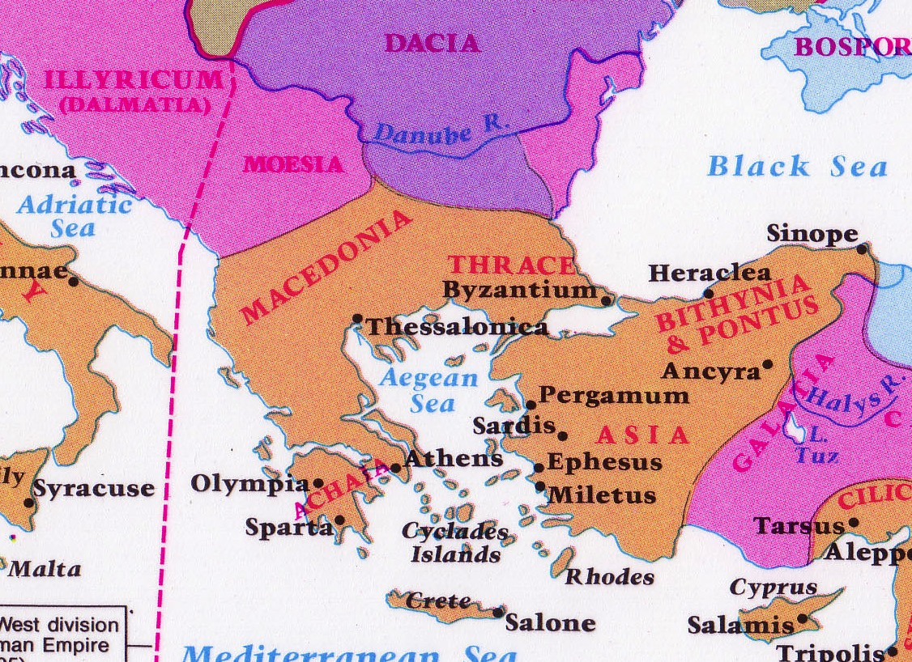
Corinth: Crossroads of Immorality
142
Corinth
Notes:
The route from Italy long required the treacherous sailing around the Corinthian Peninsula in order to arrive in the Aegean area to reach the heartland of Greek culture and trade.

Slide 13



Isthmus of Corinth
161a
7 km
Corinth
Acrocorinth
Temple of Aphrodite
Notes:
However, in the years before Christ, an ingenious business of ship transport developed. Sailors would disembark on one side of the Isthmus of Corinth, the ships would be put on logs and specialized crews rolled them on land the entire seven kilometers to the other side. This gave the sailors a few days off, so they visited nearby Corinth and then met their ship a few days later on the other side of the isthmus.

Slide 14
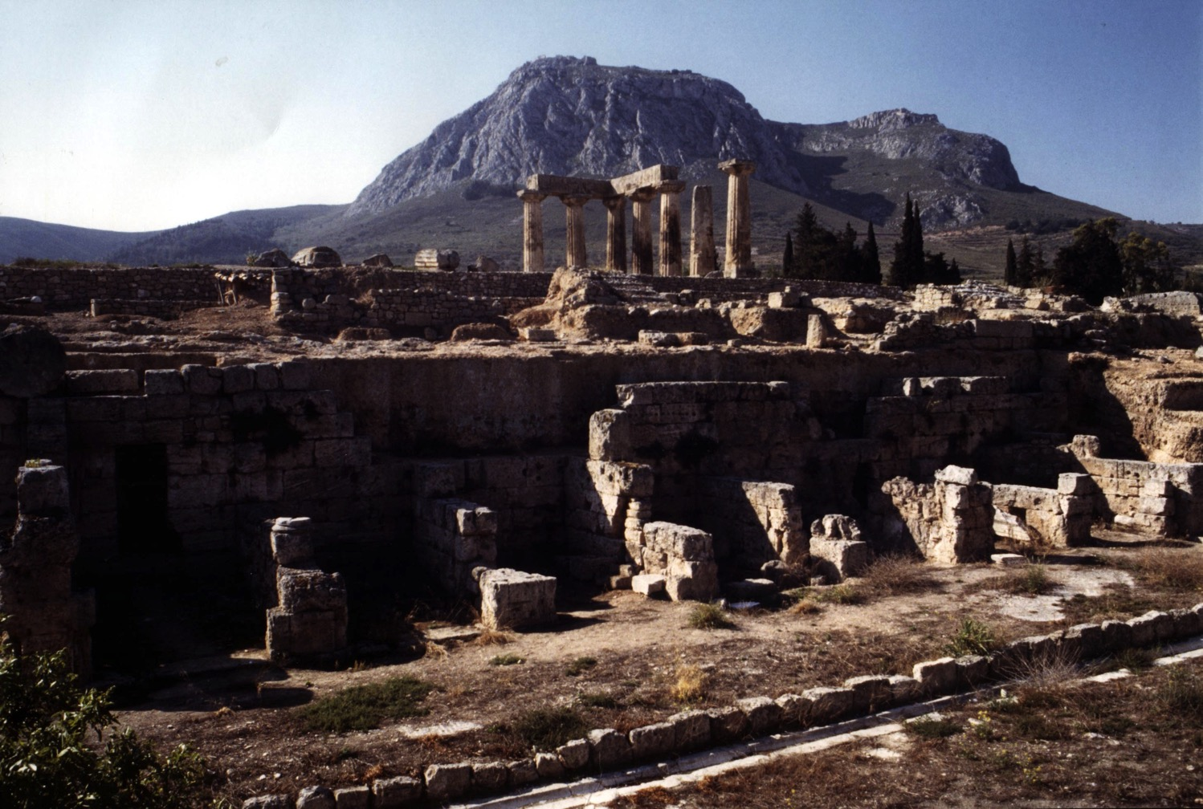
View of Acrocorinth from the City
Notes:
It takes little imagination what sailors would do with a few days off and nothing to do. Ancient Corinth was a city of so-called "free sex." The foreground has remains of the ancient city, while in the distance is Acrocorinth, the place of the ancient temple.

Slide 15
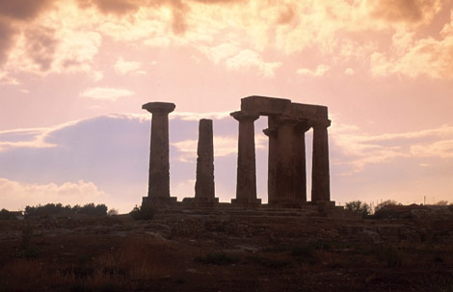
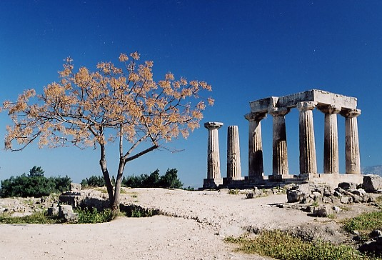
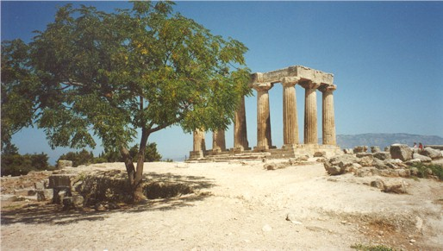
Immorality in All Seasons
Notes:
On top of Acrocorinth, a temple was open all year for so-called "worship" with one of the 1000 temple prostitutes.

Slide 16
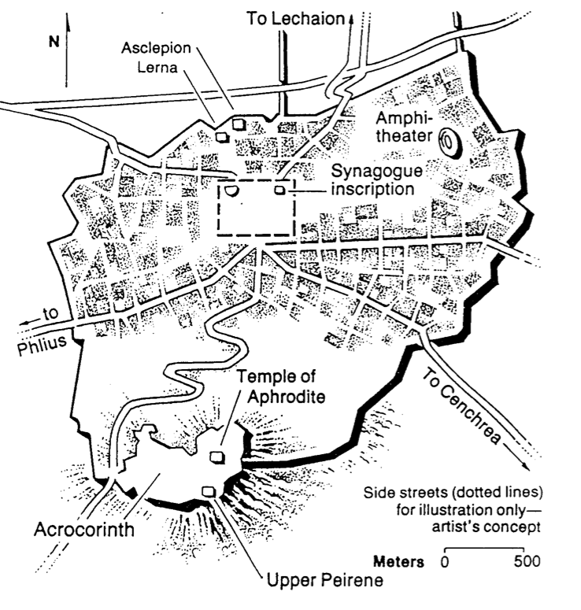
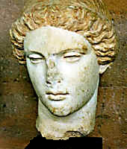
Temple of Aphrodite
Greek Goddess of Love
Notes:
She was the goddess of love, so sailors who visited Corinth had a few days of "liberty" with her priestesses to alleviate the boredom of a generally calm life at sea.

Slide 17

It takes courage not to do what everyone else is doing

Slide 18

How should we…
BE
UNITED
(1–4)
BE
DIFFERENT
1 Corinthians
…from unbelievers?

Slide 19
1 Corinthians 1

Slide 20
Key Word
120
Sanctification
1 Corinthians

Slide 21

Sanctified (1:2) = “Set apart by God as His possession”
Do you live like this?

Slide 22
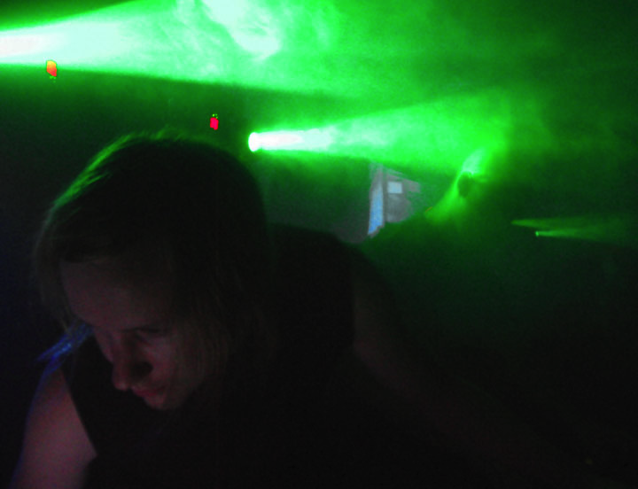
Which church leader should we follow?
A key question asked at Corinth

Slide 23
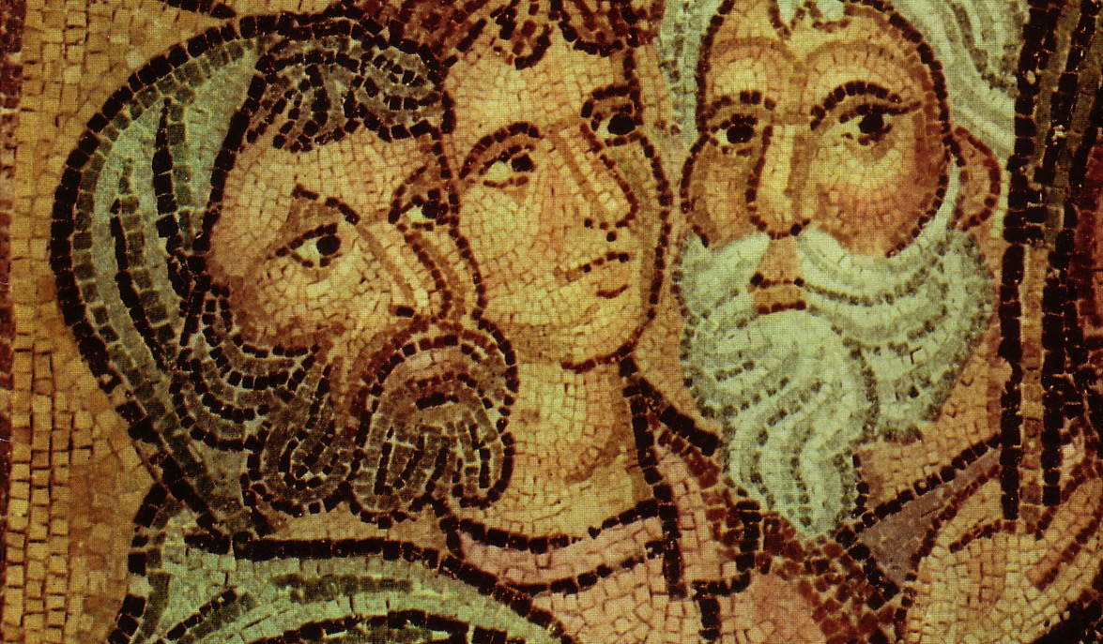
Parties at Corinth
Paul
Action
Party
P
A
P
Apollos
Yippee
Esquire
A
Y
E
Cephas
Triumph
Esquire
C
T
E
Savior
Dvlpmnt
Party
S
D
P

Slide 24
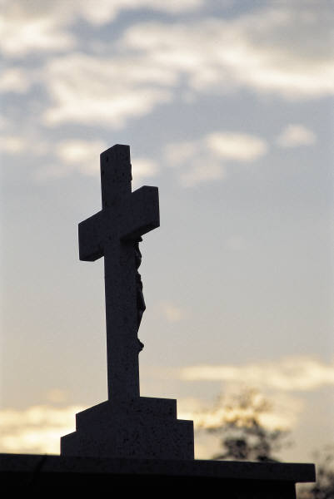
Paul's Key Point of 1 Cor. 1:
Don't divide over leaders because the gospel is based on a crucified man.

Slide 25
1 Corinthians 2

Slide 26
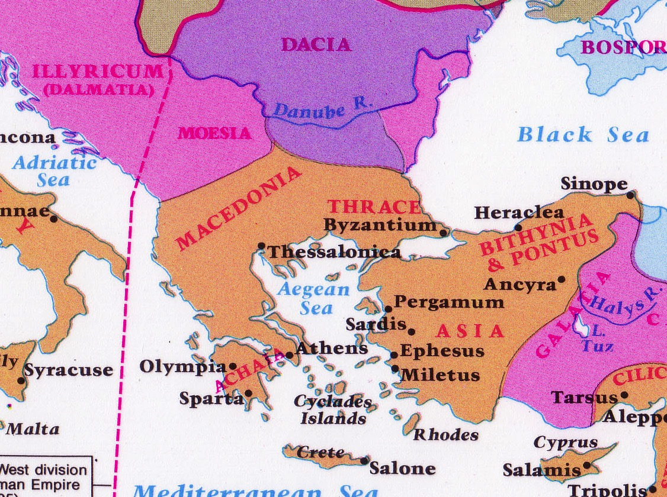
Philosophies at Athens
Athens
Corinth

Slide 27
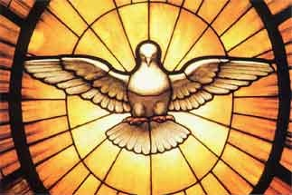
The Focal Point of the Text
We can be truly united as a church by focusing on
God's wisdom

Slide 28

What does God's wisdom look like?
Unity
Humility
Witnessing
Education
Bible

Slide 29
1 Corinthians 3

Slide 30
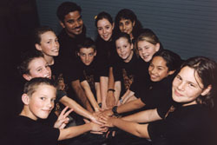
Church Unity
How can we have it?

Slide 31
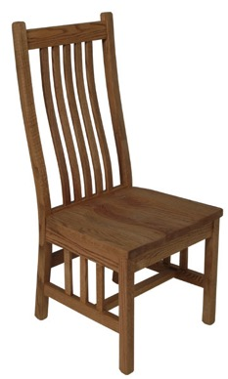
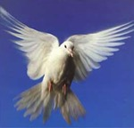

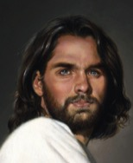
Types of People
Carnal
Christian
(3:1)
Self
Self
Self
Non-Christian (2:14)
Christian (2:15)

Slide 32
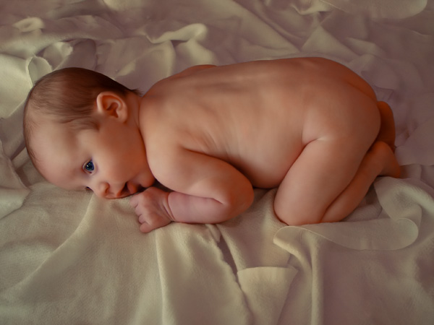
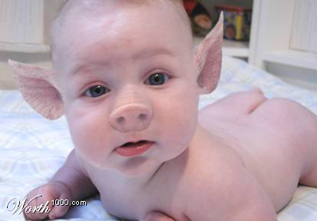
"Carnal" means "fleshly"

Slide 33
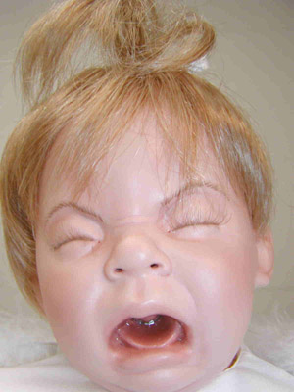
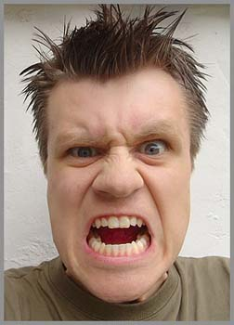
Two Types of Carnality
Sarkikos, "like flesh," 3:1
Sarkinos, "made of flesh," 3:3
Notes:
Throwing a fit is natural for a baby—but it is totally inappropriate for an adult. The Corinthians were acting like babies.

Slide 34
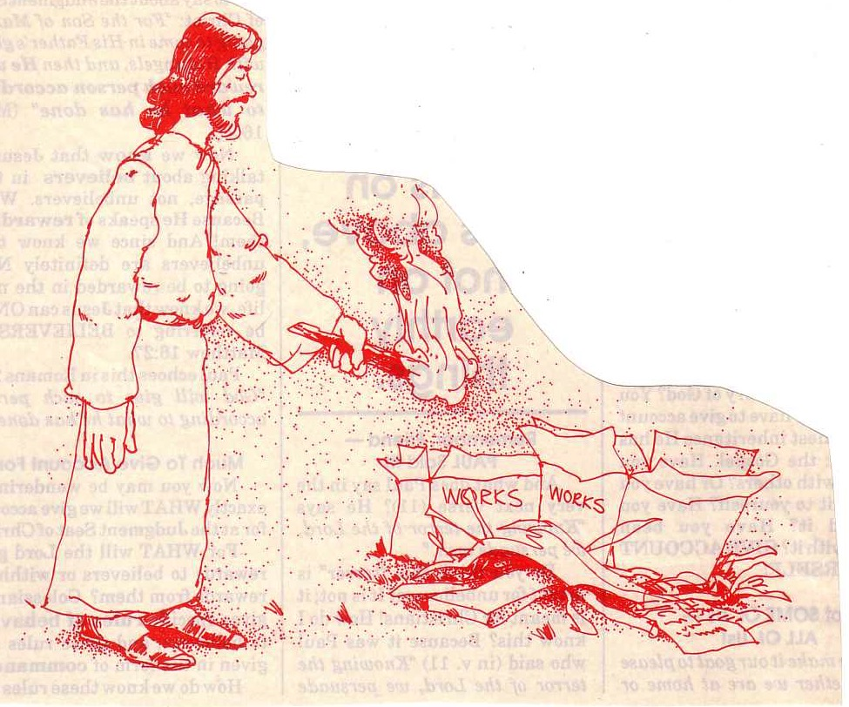
"… the fire will test the quality of each man's work"
(1 Cor. 3:13)

Slide 35


Lasting Building Materials (3:12a)
Silver
Gold
Jewels
Foundation: Apostles & Prophets (Eph. 2:20)
Foundation: The Lord Jesus Christ (1 Cor. 3:11)
Adapted from Charles R. Swindoll. "Spiritual Gifts Study Guide" (IFL, 1983), 7

Slide 36


Perishable Building Materials (3:12b)
Hay
Wood
Straw
Foundation: Apostles & Prophets (Eph. 2:20)
Foundation: The Lord Jesus Christ (1 Cor. 3:11)
Adapted from Charles R. Swindoll. "Spiritual Gifts Study Guide" (IFL, 1983), 7

Slide 37
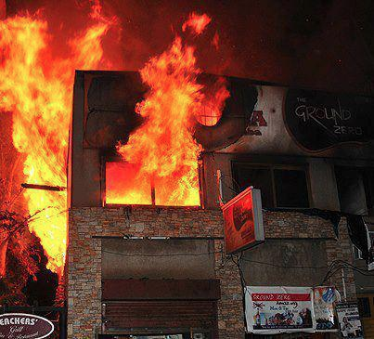
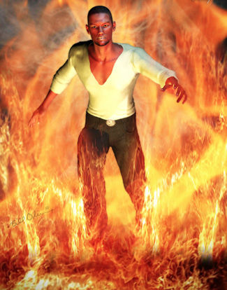
"saved as through fire…"
(3:15)

Slide 38
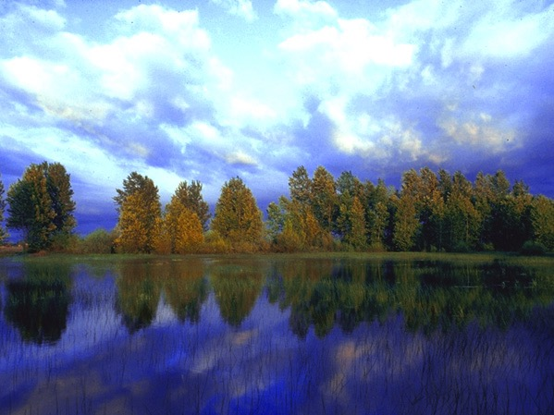
—Main Idea of 1 Cor. 3—
Unity comes from seeing all blessings as from God—not from leaders

Slide 39
1 Corinthians 4

Slide 40
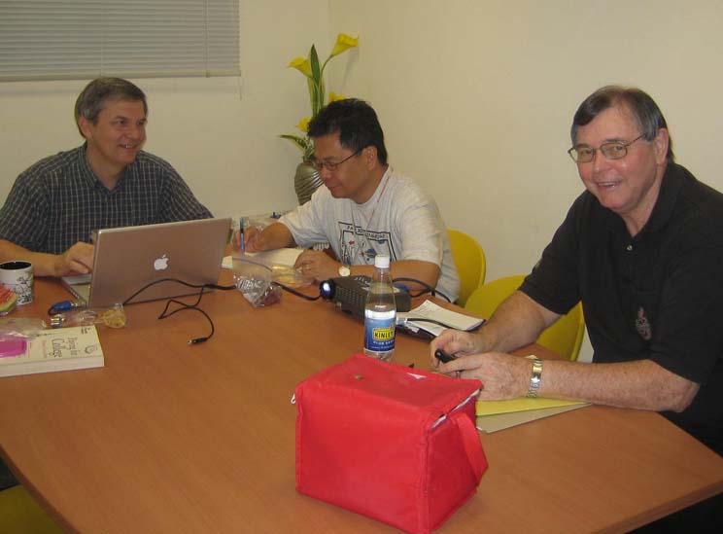
1 Corinthians 4 Subject
How should we view our spiritual leaders?
Notes:
40

Slide 41
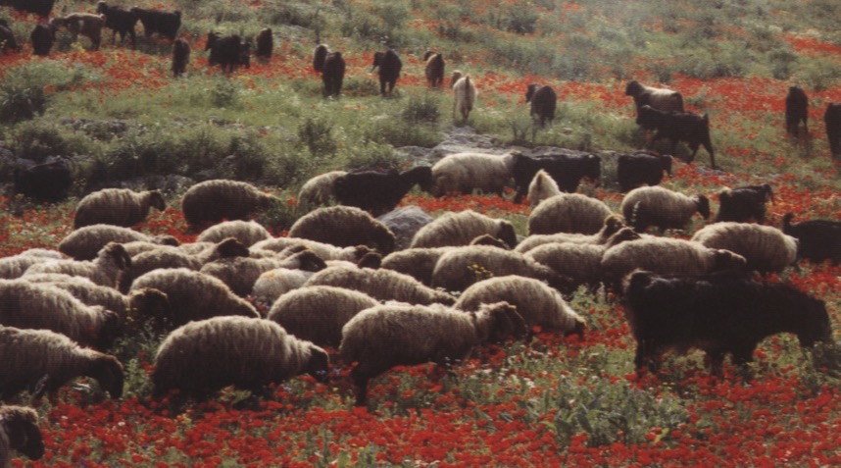
– Paul's Key Point in 1 Cor. 4 –
Treat elders with a biblical balance––
as faithful and humble servants,
yet also as spiritual fathers with authority

Slide 42
How should we…
BE
UNITED
(1–4)
BE
MORAL
(5–6)
BE
DIFFERENT
1 Corinthians
…from unbelievers?

Slide 43
1 Corinthians 5

Slide 44
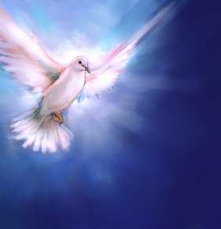
How do we maintain purity in the church?

Slide 45
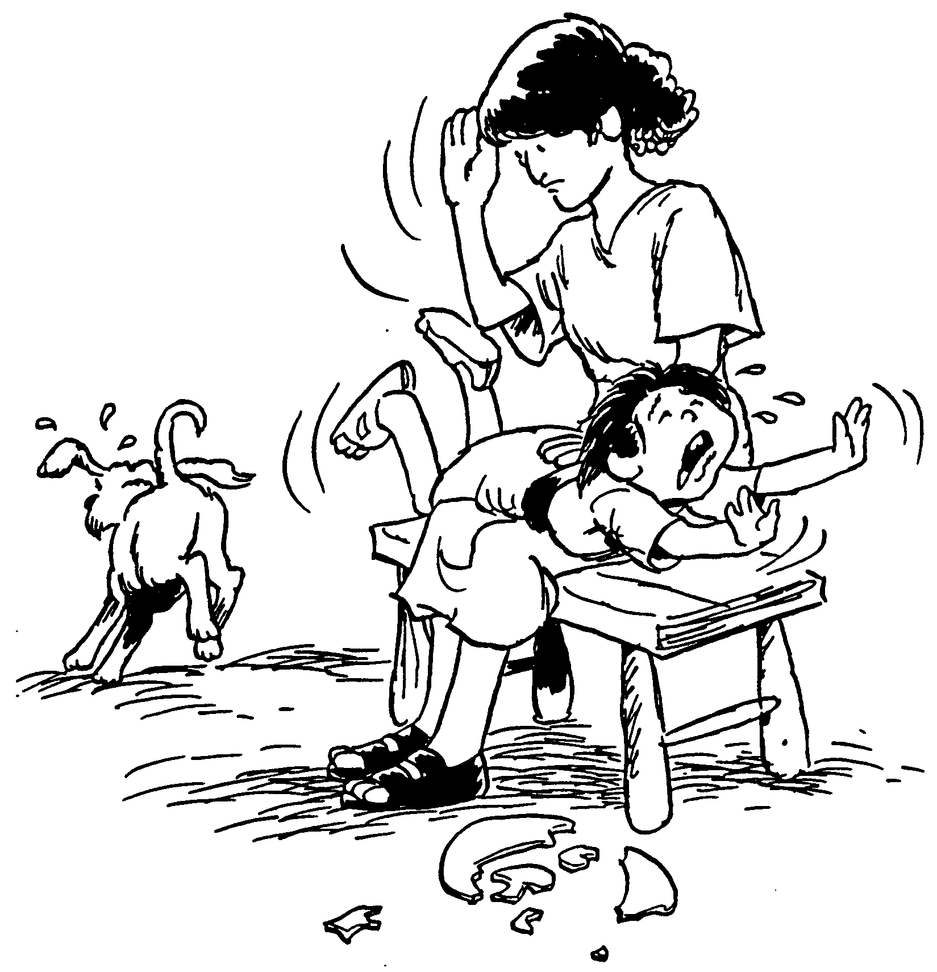
Humbly remove members living in sin (5:1-2).
Care enough to confront!
Spanking the Saints

Slide 46
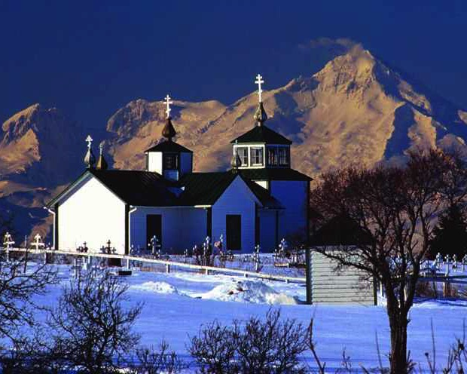
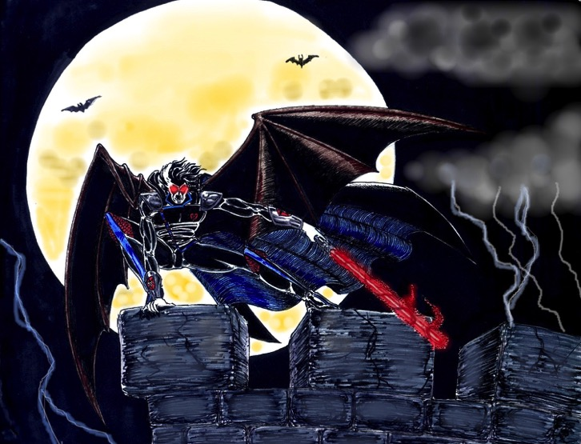
A. Discipline hands a believer over to Satan's dominion to end his hypocrisy
(5:3-5)
"…deliver over to Satan"

Slide 47
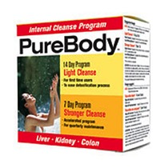
B. Discipline maintains the purity of the body
(5:6-8)

Slide 48
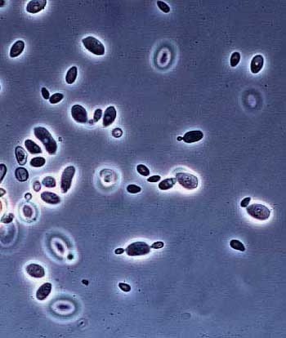
Yeast

Slide 49
The Focus of 1 Cor. 5
Guard church purity by expelling unrepentant believers
Guard church by expelling unrepentant believers

Slide 50
1 Corinthians 6

Slide 51
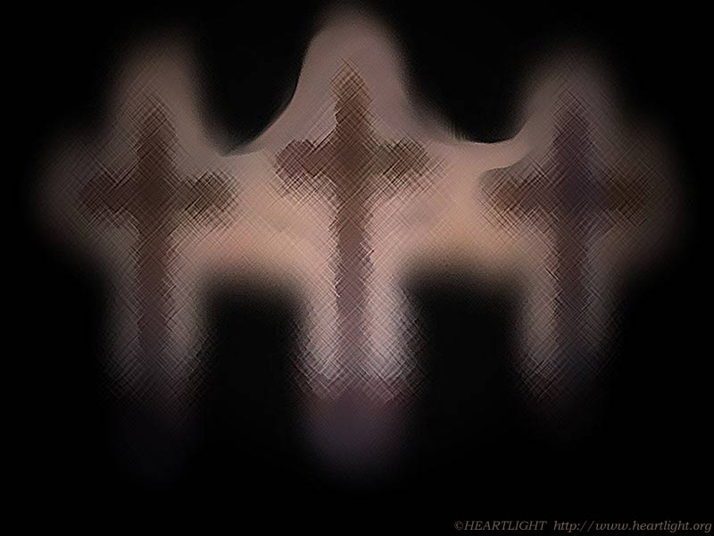
Conflicts among Christians are family matters––not for unbelievers to solve (6:1)
Why?
Competency
Witness

Slide 52
"Do you not know that saints will judge the world?"
(6:2a)

Slide 53

Disputes between believers must be solved by believers
(Main Idea of 1 Cor. 6)

Slide 54

Church Covenant
    As members of one body, we pledge to:
    (xiv) resolve all conflicts with arbitration only among believers without recourse to the secular courts

Slide 55
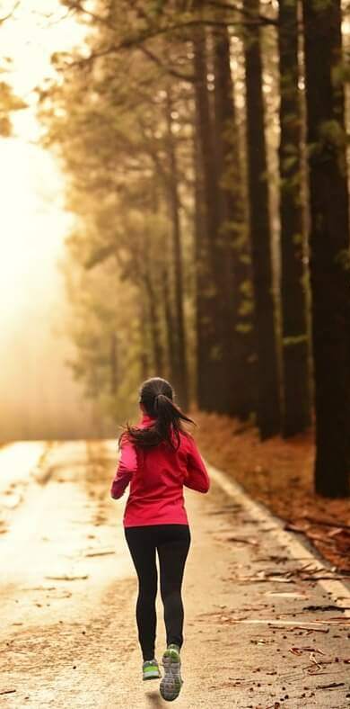
"Do you not know that your body is a temple of the Holy Spirit, who is in you, whom you have received from God? You are not your own; ²⁰you were bought at a price. Therefore honor God with your body"
(1 Cor 6:19-20 NIV).
Notes:
One of the greatest ways we witness for Jesus is how we treat our bodies.

Slide 56
How should we…
BE
UNITED
(1–4)
BE
MORAL
(5–6)
BE
DIFFERENT
BE
SELFLESS
(7–16)
1 Corinthians
…from unbelievers?

Slide 57
1 Corinthians 7

Slide 58

Are you content?

Slide 59
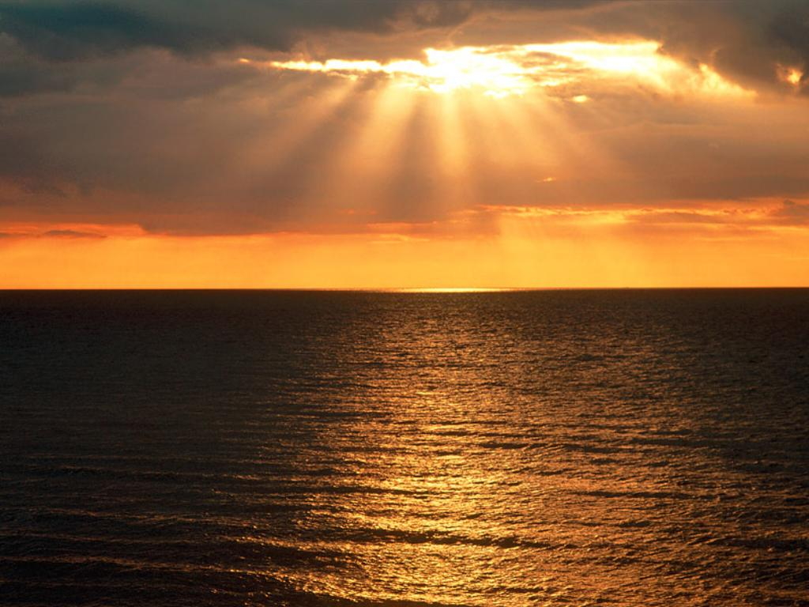
Why should you be content with your…?
  • marital state?
  • body (physical appearance)?
  • job (social standing)?

Slide 60

1 Corinthians 7 Overview
"Remain"
17, 20, 24
Marriage
7:1-24
Singleness
7:25-40

Slide 61
1 Corinthians 8

Slide 62
Where Convictions Come From…
Scripture
Conscience
View of Acrocorinth from the City

Slide 63
Black & White
Practices the Bible says are always wrong
Practices the Bible says are always right
Idolatry
Adultery
Murder
Coveting
Contentment
Obedience
Prayer
Purity

Slide 64
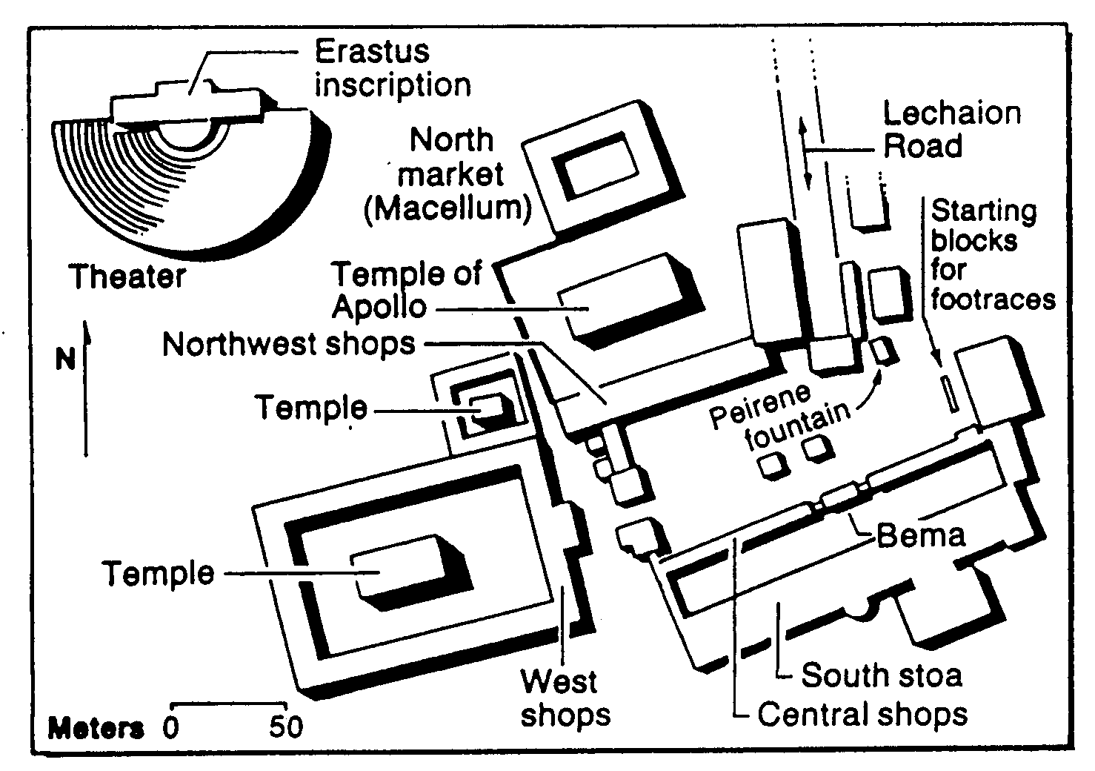
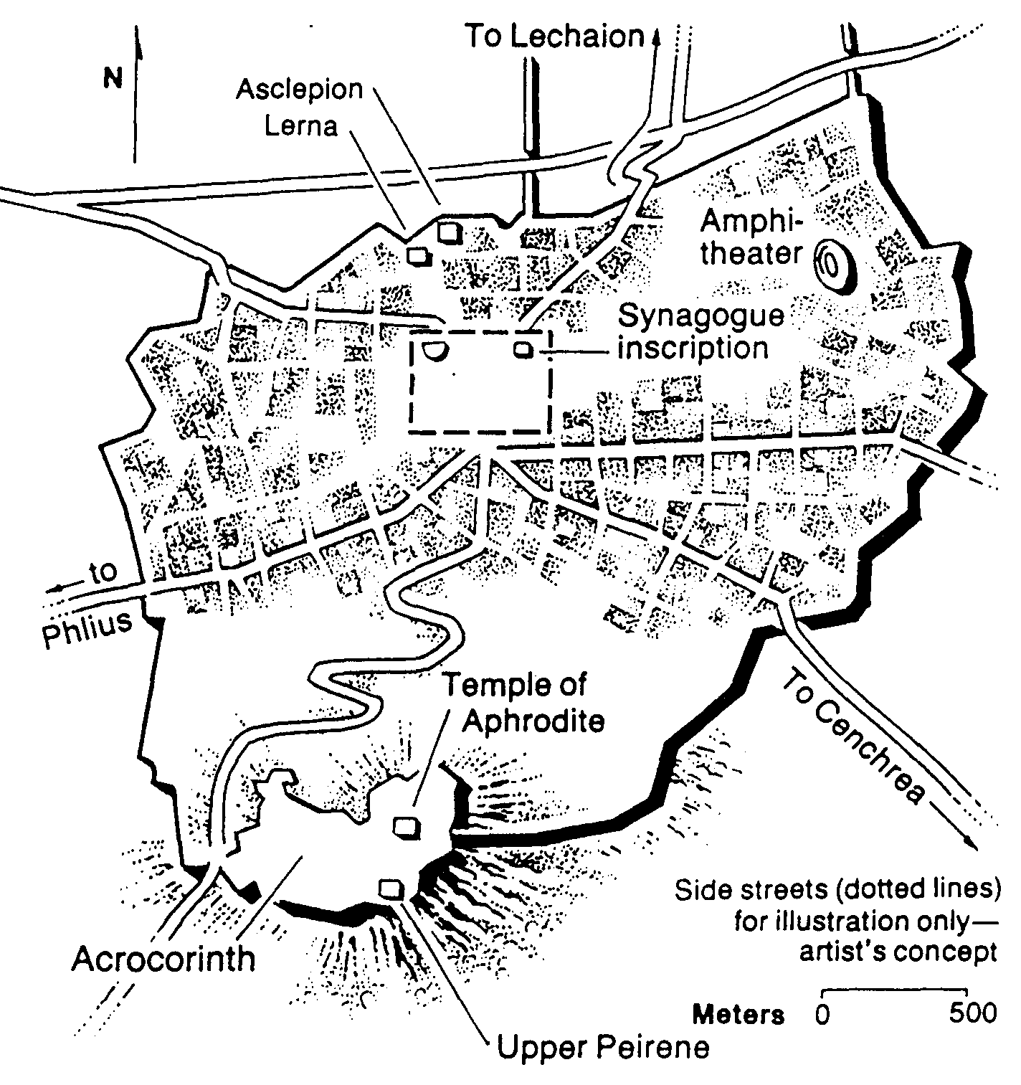
Meat & the Marketplace (1 Cor 8)
161
Bible Visual Resource Book, 235

Slide 65
Gray Areas
155aa
Practices not forbidden in the Bible over which Christians disagree

Slide 66
Gray Area Examples
155aa
Accepting gifts with the left hand
Being a Democrat (or Republican!)
Buying a Mac (or Windows) computer
Celebrating Christmas or Easter
Celebrating Good Friday
Celebrating Lent
Celebrating Palm Sunday
Changing to a "Christian" name
Chinese New Year giving of hong baos

Slide 67
Bad things happen if you insist on your rights in gray matters
(8:10-12).
You encourage your weaker brother to sin (8:10)
The weak brother could even give up his faith (8:11)
You sin (8:12)

Slide 68
Chapter 8 Big Idea
Show love more than knowledge when dealing with gray matters

Slide 69
1 Corinthians 9

Slide 70

1 Corinthians 8–10
8
Meat
9
Apostles
10
Temples
8
Gray Areas
9
Rights

Slide 71
Do those serving Christ have rights?
?
?
?

Slide 72
Give up your rights to help others mature in Christ
(Main Idea of
1 Corinthians 9)

Slide 73
1 Corinthians 10

Slide 74
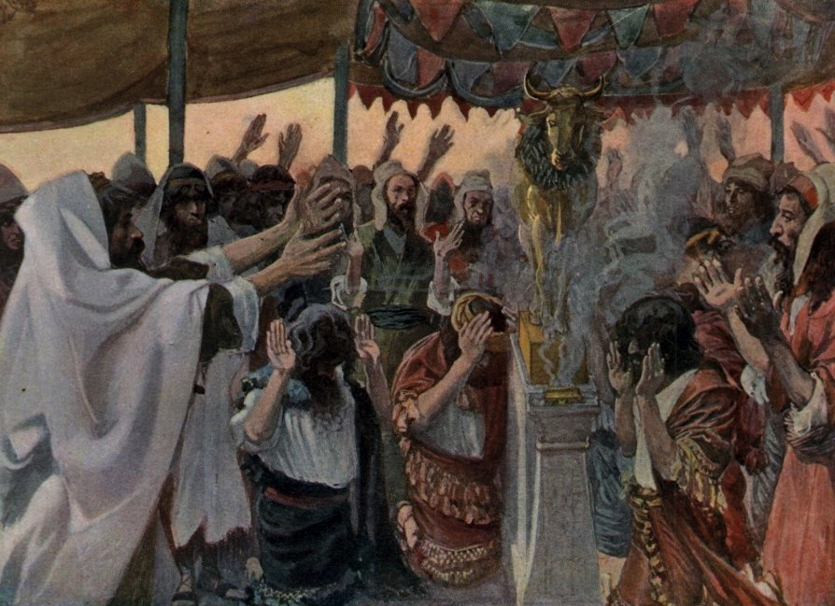
When You're Idle About Idols
1 Corinthians 10

Slide 75

Wandering Map
Kadesh- barnea
Mt. Hor
Mt. Sinai
Route of the Journey

Slide 76

1 Cor. 10:1-4 (NLT)
¹I don't want you to forget, dear brothers and sisters, about our ancestors in the wilderness long ago. All of them were guided by a cloud that moved ahead of them, and all of them walked through the sea on dry ground. ²In the cloud and in the sea, all of them were baptized as followers of Moses. ³All of them ate the same spiritual food, ⁴and all of them drank the same spiritual water. For they drank from the spiritual rock that traveled with them, and that rock was Christ.

Slide 77
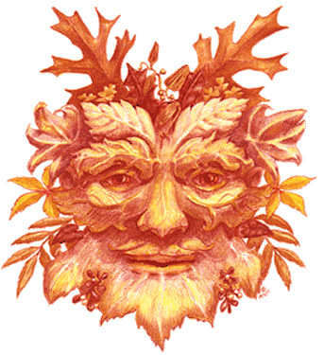
Avoid idol feasts since they're as demonic as the Lord's Supper is godly (10:14-22).

Slide 78
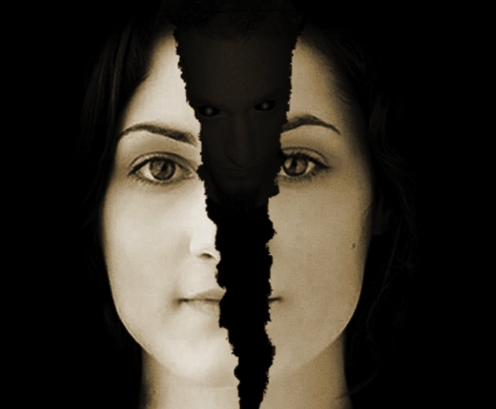
Avoid idolatry or God may discipline you for this involvement with demons
Main Idea of 1 Cor. 10

Slide 79

1 Corinthians 11

Slide 80
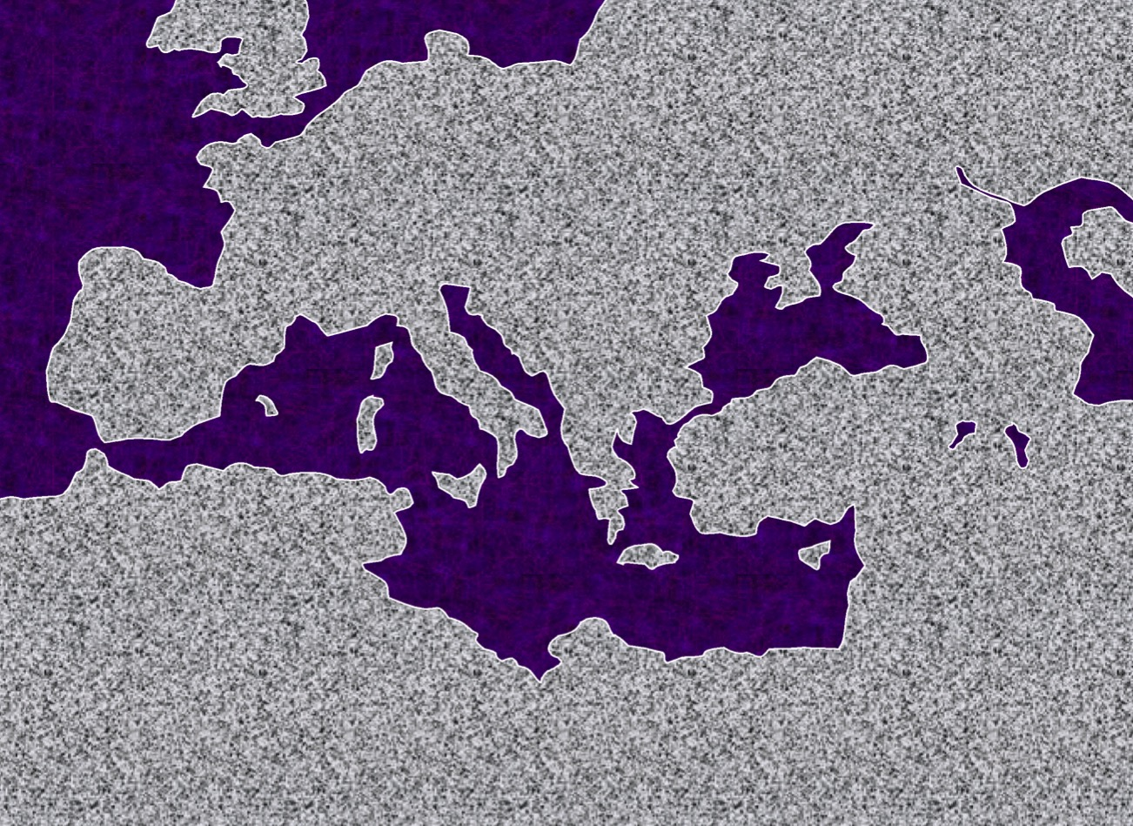
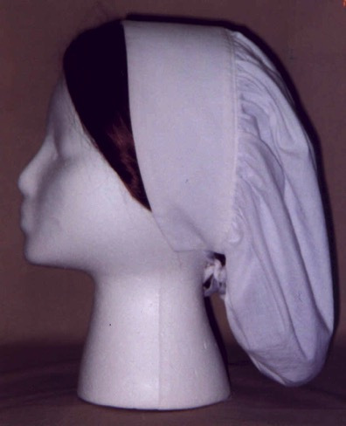
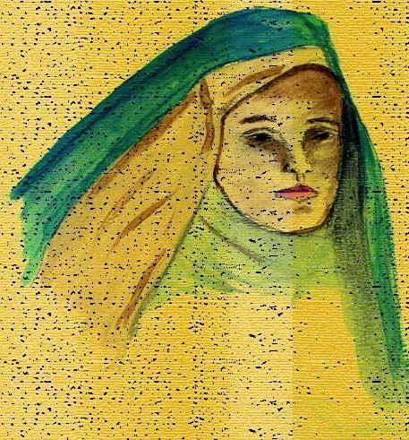

Who wore head coverings?
?
ASSYRIA
ISRAEL
Corinth

Slide 81
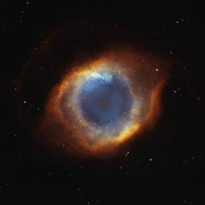
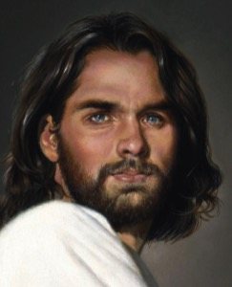
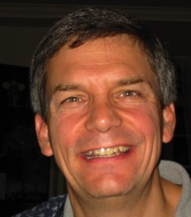

God's Authority Structure
God
Christ
The head of every man is Christ, the head of woman is man, and the head of Christ is God
(1 Cor. 11:3 NLT)
Husband
Wife

Slide 82

In most societies today, head coverings send the wrong signal––that we are out of touch with societal convention
Notes:
82

Slide 83

Don't confuse society into thinking that husbands shouldn't lead their wives (Main Idea of 1 Cor. 11:1-16)
Notes:
83
Brown's views of "free sex" finds a welcome audience in western society that has largely abandoned the marriage institution. England even has more unmarried living partners than it has married couples.

Slide 84

Give up your rights to…
• sue another believer (1 Cor. 6)
• marriage or singleness (1 Cor. 7)
• eat food offered to idols (1 Cor. 8)
• practices hindering your witness (1 Cor. 9)
• join pagan celebrations (1 Cor. 10)
• deny God's authority structure (1 Cor. 11)

Slide 85

How can you honor God in the Lord's Supper?
Notes:
85

Slide 86

Look in all four directions!
The Four Directions
outward
back
forward
inward

Slide 87
The Four Directions
(Adapted from David Watson, I Believe in the Holy Spirit)
143
Look... | Passover (Jewish) | Lord's Supper (Christian)
Outward | Whole family involved (Exod. 12:3-4, 16) | Fellowship and unity (1 Cor. 11:17-22; 10:16-17)
Back | Deliverance from Egypt (Exod. 12:31-42) | Deliverance from sin (1 Cor. 11:23-25)
Forward | Wait for messianic age (Ezek. 45:21) | Anticipate return of Christ (1 Cor. 11:26; Mark 14:25)
Inward | Purify house of leaven or evil (Exod. 12:8, 15) | Examine sin in yourself (1 Cor. 11:27-32; cf. 5:6-8)

Slide 88
To properly look back on His death and look forward to His return, we need to look outward for others and look inward at our own lives.
The Main Idea
outward
back
forward
inward

Slide 89
1 Corinthians 12

Slide 90
"Now the body is not made up of one part, but many" (12:14)
155dd
Speaking | Serving
Teaching | Administering
Evangelism | Faith
Pastor-Teacher | Giving
Encouraging | Service
 | Mercy
Notes:
90

Slide 91





Believers with less honored gifts shouldn't feel unneeded (12:15-16).
¹⁵ If the foot should say,
"Because I am not a hand, I do not belong to the body,"
it would not for that reason cease to be part of the body.
¹⁶ And if the ear should say,
"Because I am not an eye, I do not belong to the body,"
it would not for that reason cease to be part of the body.

Slide 92



"Up-front" believers, don't arrogantly say,
"I don't need you with less honored roles" (12:21)
"The eye cannot say to the hand,
"I don't need you!"
And the head cannot say to the feet,
"I don't need you!"

Slide 93

Main Idea of 1 Cor. 12
So why do you need
everyone in this church?
You're only one part of the body!
Notes:
93

Slide 94
1 Corinthians 13

Slide 95


Main Idea of 1 Cor. 13
Why must we use our gifts with love? Because…
love is superior to gifts, love benefits others, and love outlasts gifts

Slide 96
1 Corinthians 14

Slide 97

Tests of a True Prophet (Deut. 18:20, 22)
Predictions 100% true
Worships the LORD
"But any prophet who falsely claims to speak in my name or who speaks in the name of another god must die…If the prophet speaks in the Lord's name but his prediction does not happen or come true, you will know that the Lord did not give that message. That prophet has spoken without my authority and need not be feared."

Slide 98

Why can't tongues be a special prayer language?
31
Edifies others (14:26)
For unbelievers (14:22)
Not understood (14:14-15)
Limited to some (12:30)
Interpretation required (14:26-28)
Keep quiet in the church (14:28)
Outside church as a sign (14:20)
Notes:
98

Slide 99
1 Corinthians 15

Slide 100

His Body,
Our Bodies
1 Corinthians 15

Slide 101


The Full Gospel
"Let me now remind you… of the Good News [Gospel]
I preached to you before…" (NLT)
Burial
Risen
Death
"Christ died for our sins…"
"He was raised from the dead on the third day…"
"He was buried…"
1 Cor. 15:3-4

Slide 102

THE RISEN CHRIST

Slide 103

Believing the resurrection leads to hope (15:20-28)
• Hope for resurrection (15:20-23)
• Will reign with Christ (15:24-27a)
• Kingdom over all (15:27b-28)

Slide 104


Since Christ rose, you will too! So live like it!
The Main Idea of 1 Corinthians 15

Slide 105
1 Corinthians 16

Slide 106

How to advance the gospel during transition…

Slide 107


Main Idea of 1 Corinthians 16
Advance the gospel by…
giving and…
teamwork

Slide 108
Herd Mentality

Slide 109
How should we be different from unbelievers?
Notes:
What are some of the ways that God wants your life to escape the herd mentality?
How does Jesus desire you to rise above the fray?

Slide 110
How should we…
BE
UNITED
(1–4)
BE
MORAL
(5–6)
BE
DIFFERENT
BE
SELFLESS
(7–16)
1 Corinthians
…from unbelievers?

Slide 111

Main Idea
Be different by being united, moral and selfless
1 Corinthians
Notes:
Said differently, do not divide the church, do not be immoral, and do not act only for your own benefit (restatement).

Slide 112
Sanctified = “Set apart by God as His possession”
Do you live like this?

Slide 113
Black

Slide 114


NT Preaching • BibleStudyDownloads.org
Get this presentation and script for free!

